Slide 1



UNIT 5: Where I live
Ollie’s hometown

Slide 2
Do you like the place where you live?
What is the best thing about it?

Slide 3
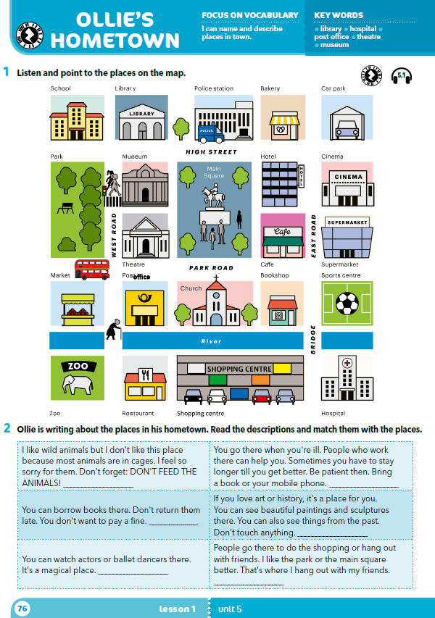
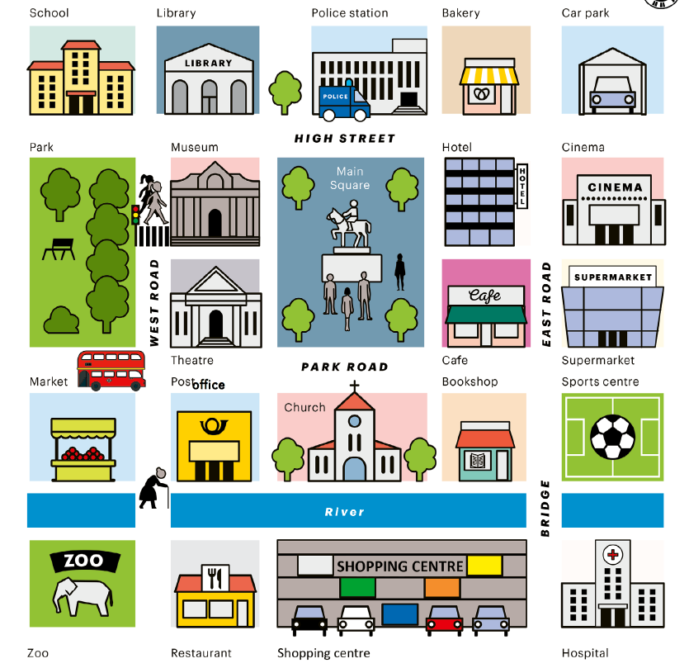
What can you see in the picture on this page?
Are any of these things in your town/village as well?

Slide 4

Listen and point to the correct picture.
https://www.e-sfera.hr/dodatni-digitalni-sadrzaji/ca320651-f7d5-4202-909e-e86d997a6273/assets/audio/34_place_in_town.mp3

Slide 5
café – hospital –
library – market –
police station – post office –
bakery – church –
car park – bookshop –
museum – sports centre –
theatre – zoo –
main square –
kafić
bolnica
knjižnica
tržnica
policijska postaja
poštanski ured
pekarnica
crkva
parkiralište
knjižara
muzej
sportski centar
kazalište
zoološki vrt
glavni trg

Slide 6
Practise : https://wordwall.net/resource/255011/ollies-hometown .
Why do people go to these places?
Why are they important? Did you ever go to: library?
police station?
cinema?
bakery ?
theatre? …
park?
car park?
museum?

Slide 7
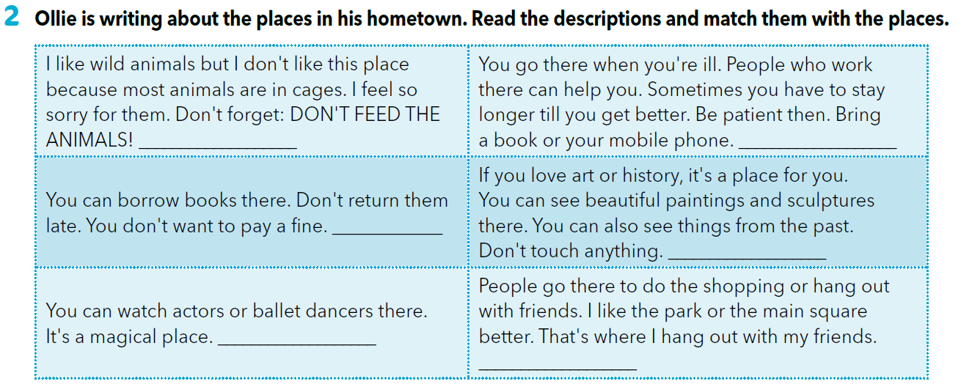
zoo
hospital
PLAY – Read and match. https://www.e-sfera.hr/dodatni-digitalni-sadrzaji/ca320651-f7d5-4202-909e-e86d997a6273/
library
museum
theatre
shopping centre

Slide 8
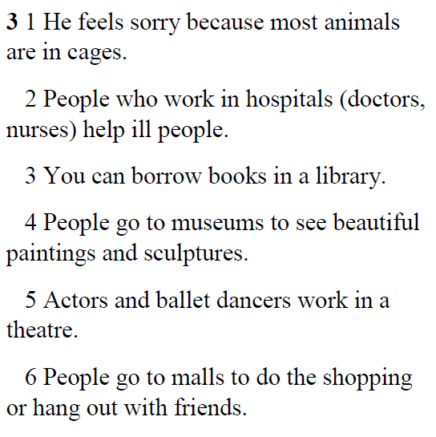
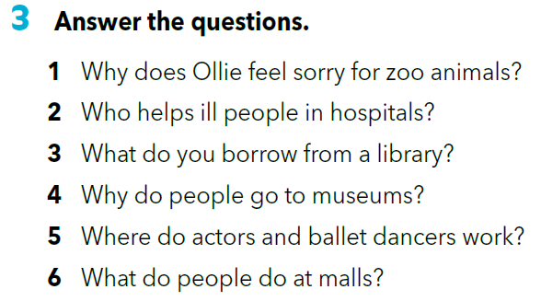
PLAY – Read and match. https://www.e-sfera.hr/dodatni-digitalni-sadrzaji/ca320651-f7d5-4202-909e-e86d997a6273/
prepositions of place
next to –
opposite –
in front of –
on the corner of –
pokraj, pored
nasuprot
ispred
na uglu

Slide 9
Close your book.
You have 10 seconds to decide whether the sentence is true or false.
The bakery is in the main square.
The church is between the bookshop and the cinema.
There is a market next to the post office.
The museum is on the corner of High Street and West Road.
A group of tourists are standing in front of the hospital.
An old lady is getting on the bus.
Two girls are crossing East Road.
The cinema is opposite the car park.

Slide 10
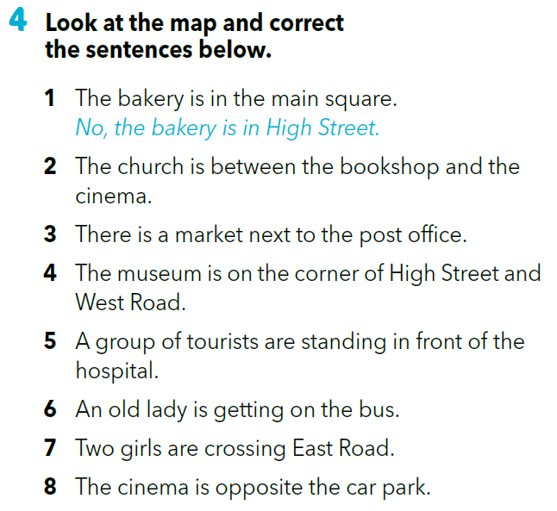
No, the church is between the bookshop and the post office.
No, there is a market opposite the post office.
No, a group of tourists are standing in front of the Main Square.
No, an old lady is crossing the road.
No, two girls are crossing West Road.

Slide 11
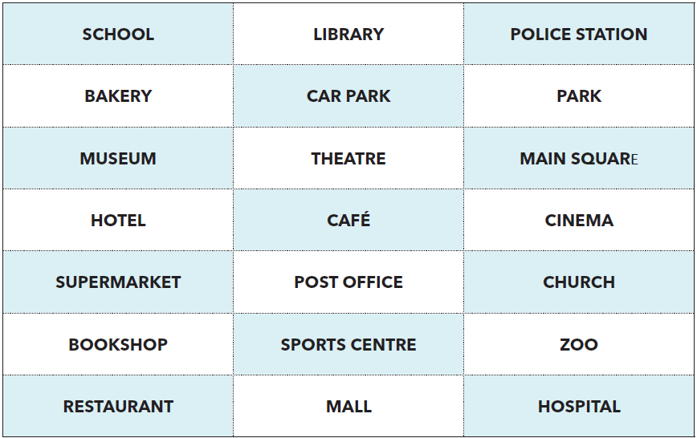
Guess the place!
Pokušaj usmeno opisati riječ s kartice bez da upotrijebiš tu ponuđenu riječ.
Ovaj zadatak možeš odigrati kao igru s prijateljima. Osobe naizmjenično opisuju mjesto bez da koriste ponuđenu riječ. Ako druga osoba pogodi o kojem se mjestu radi, zadržava karticu. Pobjednik je ona osoba koja ima više kartica.

Slide 12
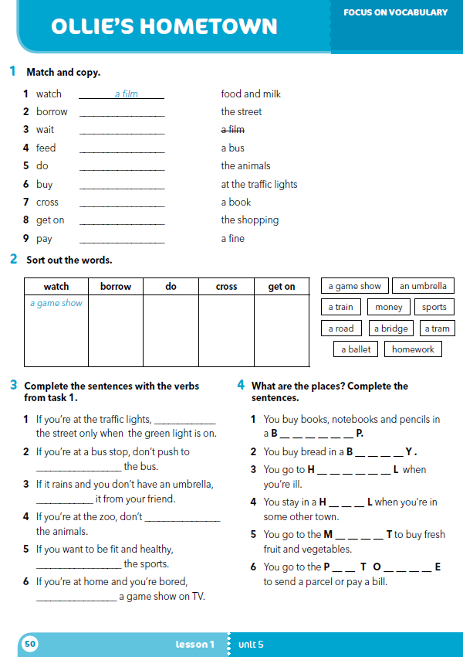
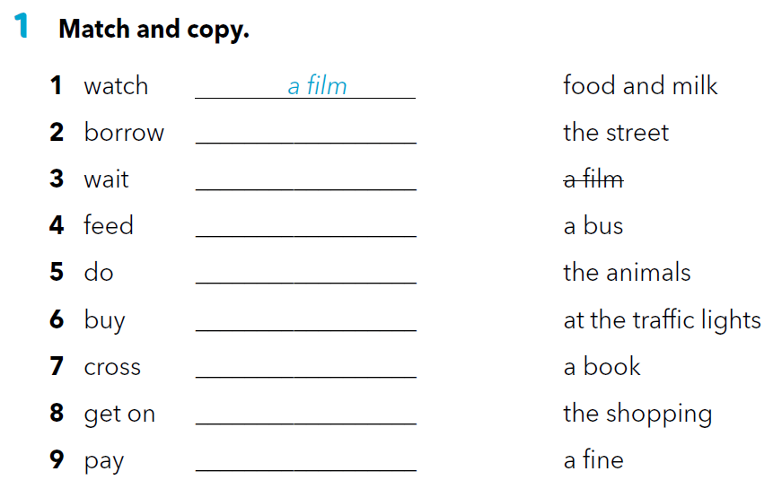
workbook p 50.
a book
at the traffic lights
the animals
the shopping
food and milk
the street
a bus
a fine

Slide 13
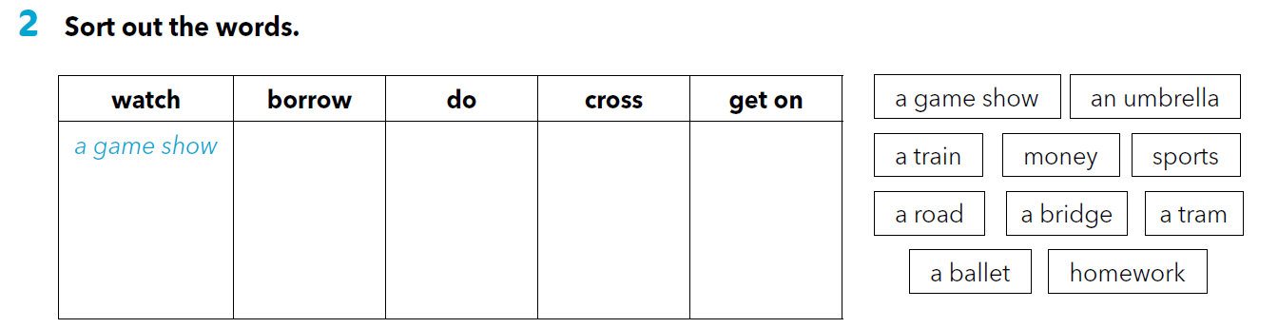
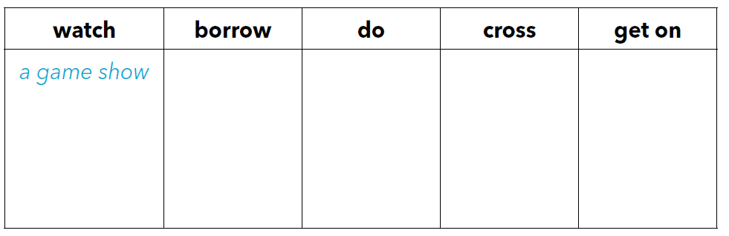
an umbrella
sports
a road
a train
money
homework
a bridge
a tram
a ballet

Slide 14
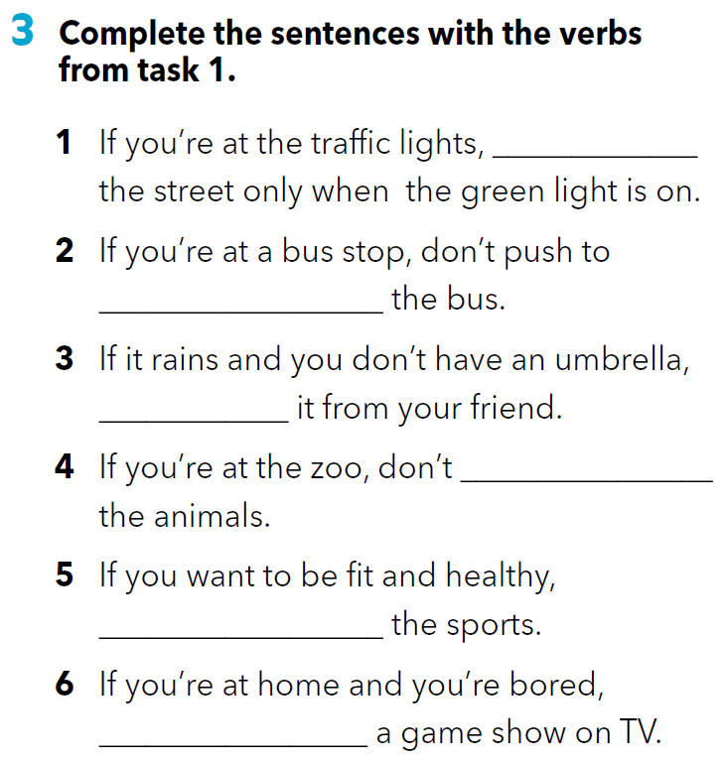
cross
get on
borrow
feed
do
watch

Slide 15
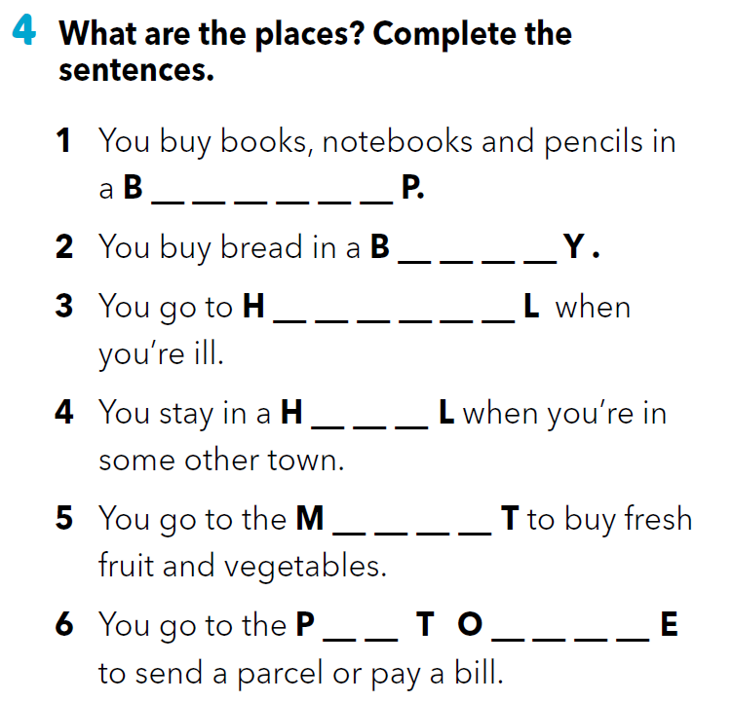
O O K S H O
A K E R
O S P I T A
O T E
A R K E
O S
F F I C

Slide 16

SELF CHECK
https://www.e-sfera.hr/dodatni-digitalni-sadrzaji/ca320651-f7d5-4202-909e-e86d997a6273/
.

Slide 17
LEARN MORE.
https://www.e-sfera.hr/dodatni-digitalni-sadrzaji/ca320651-f7d5-4202-909e-e86d997a6273/
Places in Zagreb

